Slide 1
Instructor-Course Assignment Application
aka ☺ coursebrew ☺
Sponsor: Dr. C. Rich Compeau, Texas State University, Ingram School of Engineering
Team Members: David Johnson, Kiana McDaniel, Phillip Tran
Faculty Advisor: Dr. C. Rich Compeau

Slide 2
Project Overview
WHAT IS coursebrew?
a web-based application developed to easily manage instructor-course assignments
replaces excel
REQUIREMENTS
develop software that…
is intuitive and easy-to-use
is web-based
is able to be used concurrently
is designed to be expandable
TO BE DELIVERED
coursebrew software
user documentation

Slide 3

Project Motivation
THE CURRENT SOLUTION
an excel spreadsheet is being used to manage instructor-course assignments
AS WE ALL KNOW…
excel can be a pain in the neck!
it’s hard to navigate
it’s hard to manage
it only exists on the hard drive of the user’s computer

Slide 4
Project Goals
PRIMARY GOALS
design & develop coursebrew
web interface
backend
database
develop and document installation and configuration instructions
conduct live testing with program coordinators to ensure usability
STRETCH GOALS
implement algorithm to automatically assign instructors to courses
implement the class (i.e. room, time, and student count) scheduler

Slide 5



User Interface
mouse click on ‘add course’
user lands on add a course page
mouse hover on book icon
mouse click on ‘view courses’
user lands on view courses page
home page
mouse click on ‘add instructor’
user lands on add
an instructor page
mouse hover on profile icon
mouse click on ‘view instructor’
user lands on view instructors page

Slide 6
User Interface
yes
user notified that instructor already exists
user enters instructor data in form fields
instructor matches record in DB?
add an
instructor page
mouse click on ‘ADD’
no
instructor added
form fields populated with current instructor data
user enters instructor data in form fields
**goes through same checking process as above**
view instructors
page
mouse click on an instructor’s name

Slide 7

User Interface
yes
user notified that course already exists
user enters course data in form fields
course matches record in DB?
add a course
page
mouse click on ‘ADD’
no
course added
course sections per semester shown
instructors sorted by recommendation algorithm
mouse click on a course name
mouse click on ’choose instructor’ dropdown
view courses
page
instructor assigned section
mouse click on ’SAVE and SUBMIT’
user chooses instructor

Slide 8
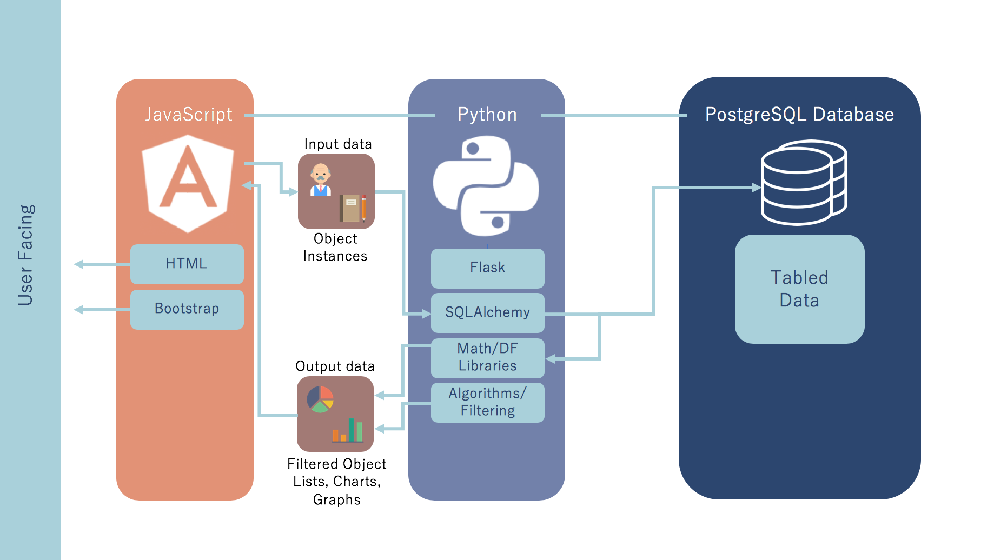
RESTful API
SQLite

Slide 9






Making an Instructor-Course Assignment
Section[]
Instructor[]
scope
{
year: 2016
user: Fred
…
}
JSON
onInit()
POST
section
{
…
id: 223
year: 2016
owner: Fred
instructor: N/A
net_id: N/A
…
}
instructor
{
name: Bob
net_id: B10
c_workload: 2
m_workload: 2
}
page
<input>
2016
Section List
belonging to Fred
</input>
warning
input Bob to section 223
3
Bob
B10
warning observable
getWarnings() GET JSON
assignment observable
instructor observable
getInstructors() GET JSON
assign() POST JSON
WHY?
update sections and instructors

Slide 10
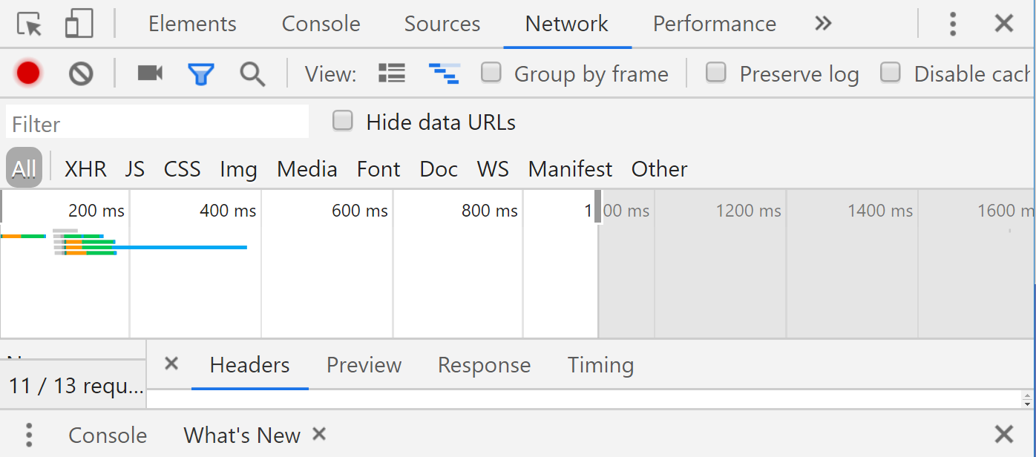
Making an Instructor-Course Assignment
no refreshes ☺

Slide 11
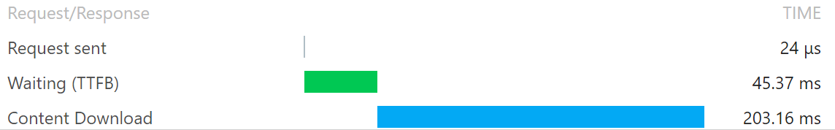
vendor.js
incur ~250ms wait every time you reload the page on top of the assignment time, synchronous call so you aren’t able to access the GUI during this time
JSON content download (payload) is very small compared to other assets

Slide 12
Database vs. Text Files
NON “DATABASE” OPTION 1
individual text files for each instructor, section, and course with directory system
NON “DATABASE” OPTION 2
parsing one very big text file
large programming overhead, with the most obvious algorithm (linear search/scan for values) resulting in O(n)
have to keep ALL data in memory as you query
n for characters vs n for record
no scalability
with small data sizes, SQLite reads and writes faster and uses less disk space as the number of records increases
Jim Gray, Microsoft/UC Berkeley (2006)

Slide 13
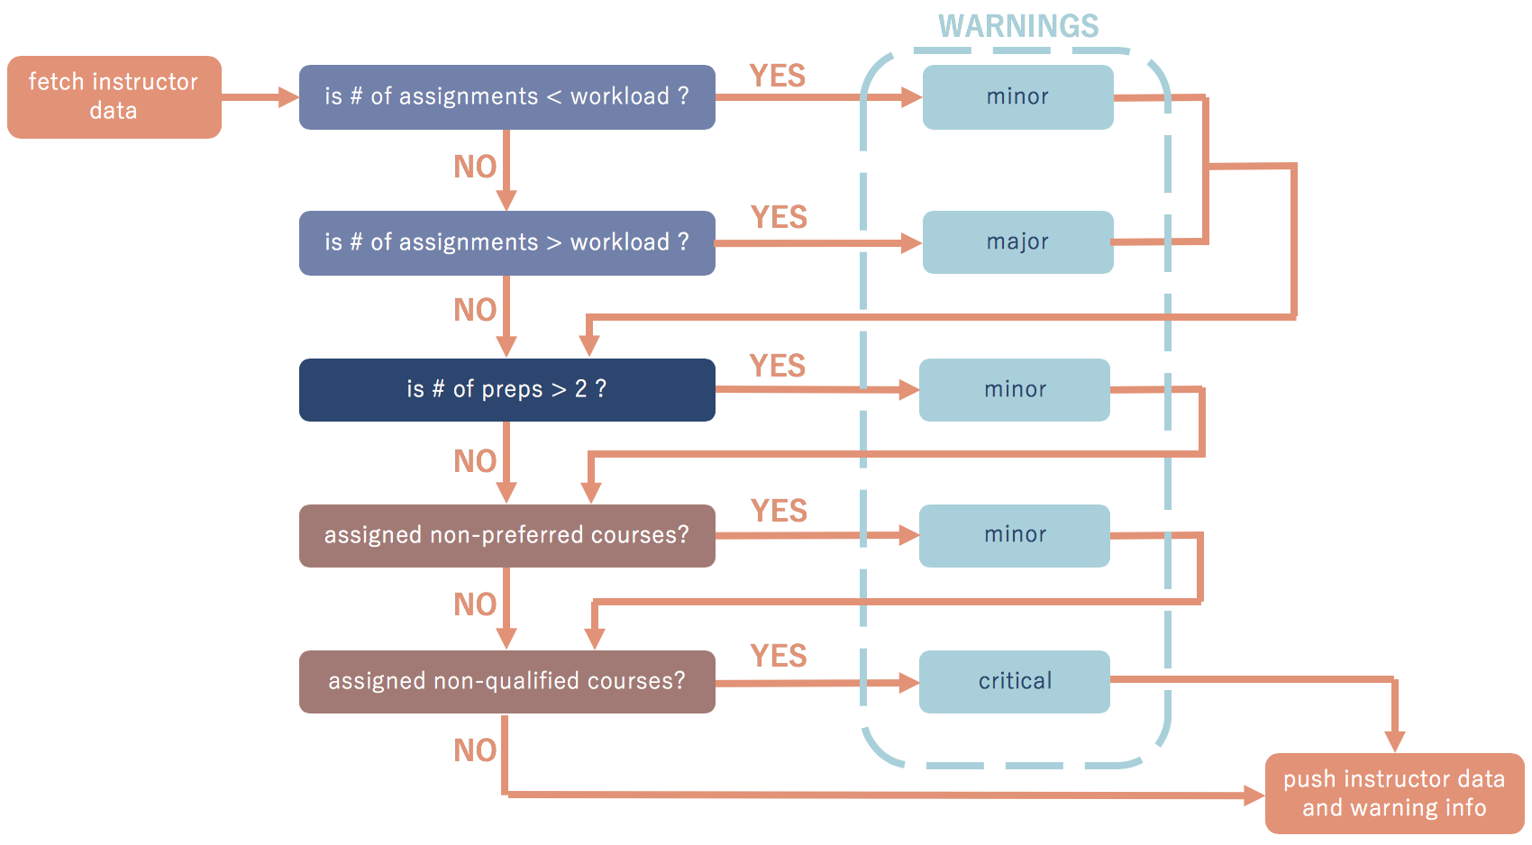
Data Handling

Slide 14
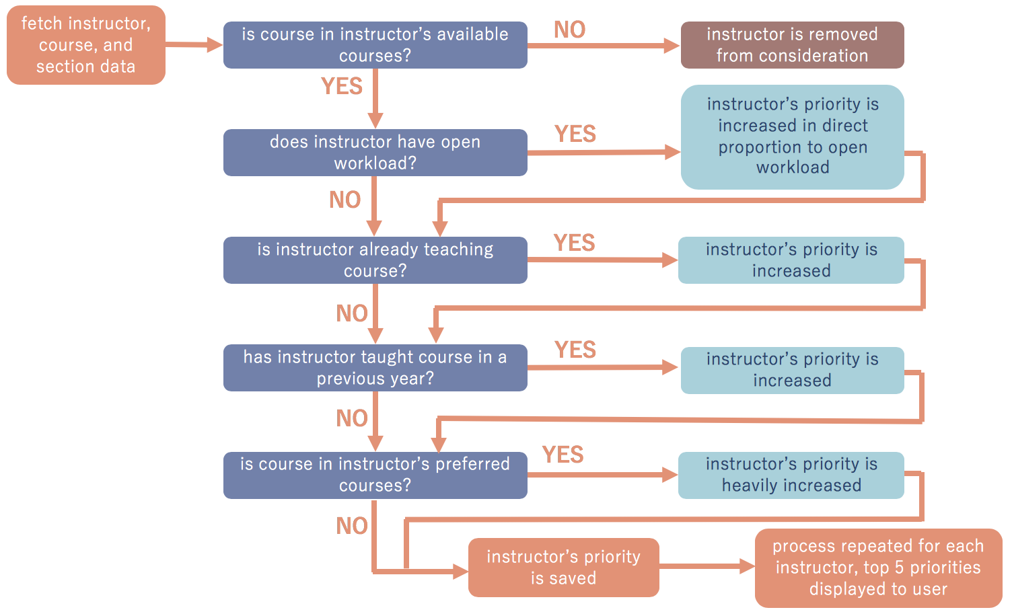
Assignment Recommendation

Slide 15
Data Storage
instructor
net_id
created
name
rank
workload
summer
year
course
course_id
created
name
owner
frequencies
year
section
section_id
instructor_id
course_id
semester
year

Slide 16
Data Storage
year
section
instructor
course
assignment
section id
semester

Slide 17
Results
 | TEST CASE | SPECIFICATIONS |  | RESULT/COMPLIANCE
 |  | input | expected output
1 | view courses | user mouse clicks to navigate web-page database’s stored course data | list of all courses currently in the system for current school year shown | http://198.58.116.113:4200/courses
2 | add course | user mouse clicks to navigate web-page user keyboard inputs to fill out course information | a form will appear that shows data fields to be entered by the user added course shown in “View Courses” page | http://198.58.116.113:4200/add-course
3 | edit course | user mouse clicks to navigate web-page user keyboard inputs to fill out course information | a form will appear that shows data fields filled with current course data edited course shown in “View Courses” page | http://198.58.116.113:4200/edit-course/EE2400
4 | view instructors | user mouse clicks to navigate web-page database’s stored instructor data | list of all instructors currently in the system for current school year shown | http://198.58.116.113:4200/instructors

Slide 18
Results
 | TEST CASE | SPECIFICATIONS |  | RESULT/COMPLIANCE
 |  | input | expected output
5 | add instructor | user mouse clicks to navigate web-page user keyboard inputs to fill out instructor information | a form will appear that shows data fields to be entered by the user added instructor shown in “View Instructors” page | http://198.58.116.113:4200/add-instructor
6 | edit instructor | user mouse clicks to navigate web-page user keyboard inputs to fill out instructor information | a form will appear that shows data fields filled with current instructor data edited instructor shown in “View Instructors” page | http://198.58.116.113:4200/instructors/SAA
7 | make an instructor-course assignment | user mouse clicks to navigate web-page database’s stored course and instructor data | a dropdown list of instructors will be shown with top 5 ”best-fit” instructors at the top of the list any appropriate warnings generated and displayed assignment reflected on the user interface | http://198.58.116.113:4200/courses/EE2400

Slide 19
Results
 | TEST CASE | SPECIFICATIONS |  | RESULT/COMPLIANCE
 |  | input | expected output
8 | assignment recommendation | database’s stored instructor data | top 5 ”best-fit” instructors listed in order of what the system has calculated to be most ideal to least ideal | visually confirmed to generate list containing professors commonly assigned to that course
9 | PDF export | user mouse clicks to navigate web-page | PDF containing all instructor-course assignments for the current year | in progress
10 | response time | standard operation of the program (simulated by first 9 tests) | response time below 50ms on average | verified to be on average 38ms, at most 48ms
11 | memory usage | standard operation of the program (simulated by first 9 tests) | memory usage below 500MB | verified to be on average 43MB, 400MB with browser bloating
12 | security | standard operation of the program (simulated by first 9 tests) | encrypted data streams transmitted data not recovered by entities outside of the system | in progress
13 | system stability | standard operation of the program (simulated by first 9 tests) | webpage not “crashed” by a series of statistically random inputs | currently passing by monkeytest, must be reverified as program is changed

Slide 20
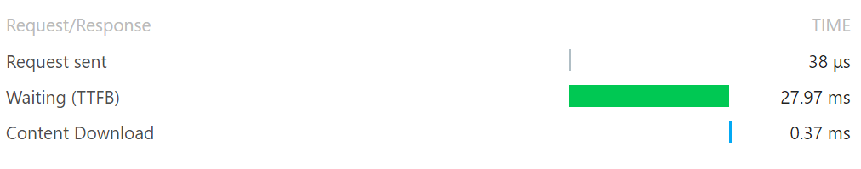
Results
10 | response time | standard operation of the program (simulated by first 9 tests) | response time below 50ms on average | YAY
all components report under 50ms TTFB, with average being ~38ms, maximum 45.02ms, minimum 27.97ms; server is located in Dallas, Texas

Slide 21
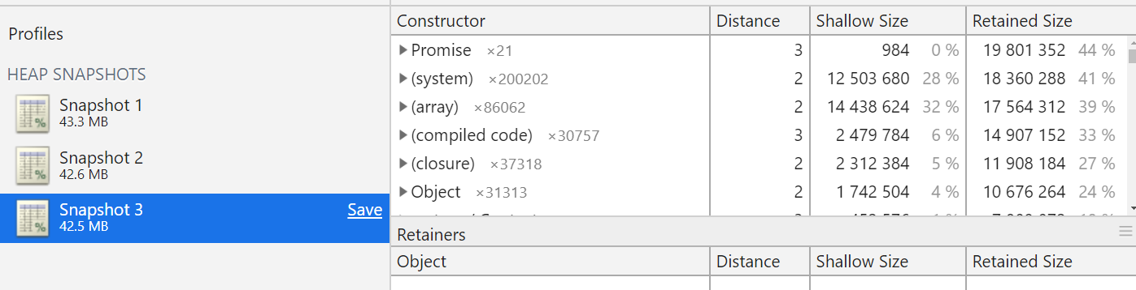
Results
11 | memory usage | standard operation of the program (simulated by first 9 tests) | memory usage below 500MB | good
average = 42.8MB
with Chrome Overhead = ~400MB, nonrelated addons included

Slide 22
System Deficiencies
LOG IN SYSTEM
coursebrew needs to be secure
talked with ITAC to see if we can integrate Texas States’ log in system with coursebrew
since they can’t provide the system, create one on our own by implementing a temporary solution
temporary solution currently in place

Slide 23
Lessons Learned
DON’T RELY ON OUTSIDE SOFTWARE INTERFACES
Texas State has strict requirements for anyone who wants to integrate their software with their log in system
confirm that any software interfaces you plan on using have functions that are consistent with your requirements
START WITH A COMPLETE DATABASE SCHEMA
having to add new attributes to an entity is a bigger job than you think

Slide 24
Acknowledgements
A BIG THANK YOU! ☺
Dr. Compeau (Sponsor & Faculty Advisor)
Mr. Hinkle (Instructor)
Dr. McClellan (Faculty Advisor)
thank you so much for your guidance. we really appreciate it!

Slide 25
Extra Slides for Questions

Slide 26
Login System
IP: 13.333.333.37 METHOD: POST PROTOCOL: HTTPS …
scope
{
data..
}
scope
{
user: Fred
password: pass123
year:
default_year:
token:
}
scope
{
user: Fred
password:
year: 2019
default_year: 2019
token: XDDD
}
Login cache
Username| Password
Fred | pass123
23.122.45.33 - Bob
21.322.112.324 - Sally
13.333.333.37 - Fred
RETURN RESPONSE
scope
{
user: Fred
default_year: 2019
token: XDDD
}

